Slide 1
Notes:
Please keep this, this will be a placeholder to have up on the screen when you aren’t presenting.

Slide 2
BEHAVIORAL RISK ASSESSMENT AND MANAGEMENT TRAINING
Glen Moore, MSW, EALOB
Notes:
Speaking Notes:
This is where you put the name of your presentation.
There are some Colorado-specific slides which are set to be “skipped.” I left them for informational purposes.
There is a lot of content in this course, so teach efficiently and be certain to leave enough time for them to work on the group scenario(s).
There are also some highlighted materials contained in the presentation notes to help ensure that the concepts are covered/explained with fidelity. Most of this material is not present on the slides and the students may not otherwise have access to it if not covered by your instruction.

Slide 3
The foundation of this presentation and the associated forms were developed by the Colorado School Safety Resource Center.
www.Colorado.gov/CSSRC
(303) 239-4435
Notes:
Speaking Notes:
Explain to the participants that the terms “threat assessment” and “behavioral risk assessment” will be used interchangeably.
Similarly for the terms “Response, Management, and Support plans (RMS)”, and “case management”.

Slide 4
Goals of the Course
Understand why violence prevention is possible and how risk assessment works.
Understand the role of relationships within the culture of the school
Learn what makes for an effective risk assessment team and program
Know basic legal issues, confidentiality
Understand the importance of safe school climates and strategies to enhance school climates.

Slide 5
Course Objectives
Identify and define the six steps of the path to violence.
List and define the steps of the risk assessment process.
Discuss the elements of an effective school risk assessment program.
Identify information cases that may be shared regarding FERPA and HIPAA.
Table discussion: What's your current process? Give examples of strategies that worked, and strategies that were problematic.

Slide 6
I N T R O D U C T O R Y I N F O
Basic Beliefs
Is the subject on a path to violence?
A team approach is most effective for gathering and evaluating risk and situational information, and providing necessary interventions including community referrals.
The process of risk assessment and case management is to mitigate or eliminate the risk with a team approach.
Engagement with a subject or person of concern can be critical to preventing harm or a violent act.
Notes:
Speaker Notes: When we evaluate the information gathered, we essentially ask whether the subject of concern is on the pathway to violence that I will describe and explain in detail a bit later.
It can be very helpful to use a team of people to gather and evaluate the information because information can be gathered more quickly and easily.
Finally, from our work we know that threat assessment is most effective when it is not adversarial. It is not a matter of finding “the bad guys” before they can do us harm. Instead, it is usually most successful when a team, or someone designated by the team, can engage with the subject of concern, to work with them to solve underlying problems and move them away from thoughts of violence.
When we evaluate the information gathered, we essentially ask whether the subject of concern is on the pathway to violence that I will describe and explain in detail a bit later.
It can be very helpful to use a team of people to gather and evaluate the information because information can be gathered more quickly and easily.
Finally, from our work we know that threat assessment is most effective when it is not adversarial. It is not a matter of finding “the bad guys” before they can do us harm. Instead, it is usually most successful when a team, or someone designated by the team, can engage with the subject of concern, to work with them to solve underlying problems and move them away from thoughts of violence.

Slide 7
T A B L E D I S C U S S I O N
What Are You Doing Now?
At your table, discuss what your district does when you receive threatening and/or concerning information.
Feel free to discuss:
Successful strategies
What did not work
Past training
Anything else you feel is relevant
Notes:
Speaker Notes: When we evaluate the information gathered, we essentially ask whether the subject of concern is on the pathway to violence that I will describe and explain in detail a bit later.
It can be very helpful to use a team of people to gather and evaluate the information because information can be gathered more quickly and easily.
Finally, from our work we know that threat assessment is most effective when it is not adversarial. It is not a matter of finding “the bad guys” before they can do us harm. Instead, it is usually most successful when a team, or someone designated by the team, can engage with the subject of concern, to work with them to solve underlying problems and move them away from thoughts of violence.
When we evaluate the information gathered, we essentially ask whether the subject of concern is on the pathway to violence that I will describe and explain in detail a bit later.
It can be very helpful to use a team of people to gather and evaluate the information because information can be gathered more quickly and easily.
Finally, from our work we know that threat assessment is most effective when it is not adversarial. It is not a matter of finding “the bad guys” before they can do us harm. Instead, it is usually most successful when a team, or someone designated by the team, can engage with the subject of concern, to work with them to solve underlying problems and move them away from thoughts of violence.

Slide 8
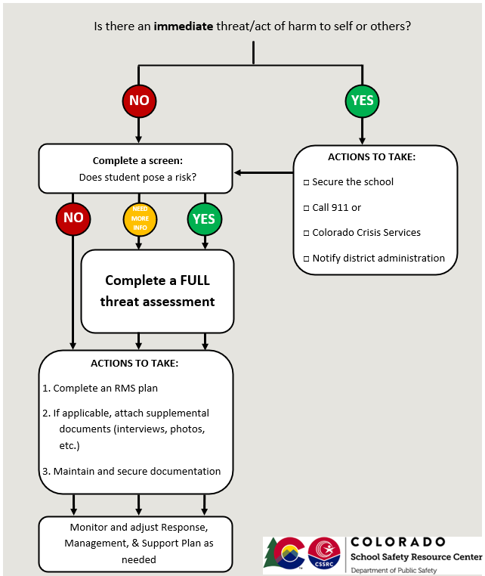
Threat Assessment Flowchart (Colorado example)
Notes:
Speaker Notes:

Slide 9
G E T T I N G S T A R T E D
Team is Comprised of:
School administrator
School Counselor/Social Worker/Nurse
Teacher
School Resource Officer/Local Law Enforcement Officer
Others – you decide
Notes:
Speaking Notes:
Building level administrator, school counselor, a teacher, and school resource officer. If the building/district does not have a school counselor or school resource officer, a community based licensed professional counselor or licensed clinical social worker, and a local law enforcement officer may serve on the team. Relationships.
Again, a team may be only serving a building or the whole district – there can be variations of how this is built in each district. We recommend a strong emphasis on relationships. If there is only one team for the district, it is advised that all faculty and staff be trained in the process so they can be that open door that leads to the team for the district.

Slide 10
G E T T I N G S T A R T E D
Risk Assessment Team
Multi-disciplinary composition enhances team’s ability to:
Identify
Gather
Assess
Manage
Notes:
Speaking Notes:
We recommend that schools create a multidisciplinary risk assessment team that is based in the school or the school district. Schools should not wait until a crisis occurs to establish a risk assessment team. Many schools across the country already have established teams to respond to a wide range of situations, from suicides to meeting special education needs. The expertise and knowledge of any existing teams may be useful in developing a threat assessment team.
Team members should be trained together in the threat assessment process. Multidisciplinary training sessions provide opportunities for professionals in different systems to build relationships and to consider how to address issues before a crisis arises. Training that uses practical exercises–"what should we do if…"–can enhance threat assessment and management programs and processes.
The multidisciplinary threat assessment team’s principal responsibility is to guide the assessment and management of situations of concern. A senior school administrator should chair the team. Regular members of the team ideally should include: 1) a respected member of the school faculty or administration; 2) an investigator, such as health professional, such as a forensic psychologist, a clinical psychologist, or a school psychologist; and 4) other professionals, such as guidance counselors, teachers, coaches, and others, who may be able to contribute to the threat assessment process. In addition, the chair of the threat assessment team may wish to consider including as an ad hoc member of the team someone who knows the subject of concern in the threat assessment inquiry. This ad hoc position might be held by an individual from the school community, such as a teacher, counselor, coach, nurse, other school employee, or someone from the community who may know or have knowledge of the subject, such as a probation officer, member of the clergy, or a social service worker. If the subject of concern is being provided services under the Individuals with Disabilities in Education Act (IDEA), a representative from the team that developed or manages that subject’s Individualized Education Plan (IEP) also should be brought onto the threat assessment team as an ad hoc member for the inquiry regarding this particular subject. Having team members from multiple disciplines can help the team identify cases of concern from a broader cross section of the school; it can help the team gather information faster and more easily, through contacts the team members already have throughout the school; it can help improve decision-making in the assessment by encouraging discussion of multiple viewpoints; and, it can help the team access multiple intervention resources and monitor subjects of concern more effectively.

Slide 11
THE PURPOSE OF RISK ASSESSMENT
The purpose of risk assessment, above all else, is to prevent a foreseeable act of violence at school or in relation to school.
Not to:
Punish or justify disciplinary action
Justify criminal prosecution
Substitute for clinical, diagnostic, or psychological assessment
Substitute for effective behavior planning, including functional behavior assessment
Notes:
Speaking Notes: Purpose is all of the things discussed on previous slide and here, NOT the bullet points
Presenter Notes:
References:
Image:

Slide 12
Risk Assessment Connections
THE PURPOSE OF RISK ASSESSMENT
Suicide Risk Assessment
The Discipline Process
Intensive Mental Health Support
IEP/ SPED
Self-Injury Assessment
Notes:
Speaking Notes: Other topics may come up during a TA, but this tool is designed only to address threats of targeted acts of school violence. Emphasize suicide risk assessment is a separate process that must be completed by trained mental health professional who knows the proper questions to ask, resources to utilize, and can make an adequate safety plan, etc. Point out “red box” in Screen and Full Assessment that asks if a SRA needs to be completed in addition to the TA. Questions are often asked about IEP/504. Make sure to include special education representative in process to address these questions and make sure RMS works with other plans.
Presenter Notes:
References:
Image:

Slide 13
THE PURPOSE OF RISK ASSESSMENT
School Risk Assessment Process
Learn about a subject of possible concern
Gather information about the subject and his/her situation.
Use information to answer 11 Key Questions.
Make evaluation / assessment
Develop and implement case management plan (RMS)
Notes:
Speaking Notes:
Once the team learns of a subject of concern, the team gathers more information about the subject from various sources. The team should think creatively about where to look for information. In this day and age, we always include an Internet search on all of the case we handle – searching for the subject’s name, the school’s name, and the names of anyone threatened or known to be targeted.
The team will then analyze the information using key questions from the US Department of Education and Secret Service threat assessment guide. We’ll review those questions in just a minute.
The team will then use their answers to the investigative questions to evaluate the subject and their situation to determine whether they pose a threat of violence or self-harm – or if they are otherwise in need of some help.
If the team believes the subject poses a threat, the team will then develop and implement a case management plan, and then monitor the plan to see if it is working as intended. The team will continue to monitor and follow up on the case as needed – gathering more information and re-evaluating whenever necessary.

Slide 14
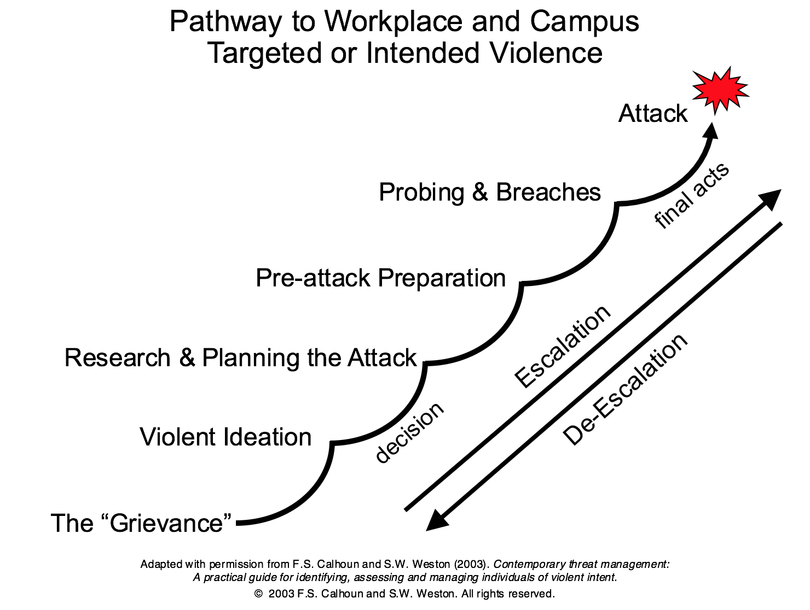
THE PURPOSE OF RISK ASSESSMENT
Pathway to Violence
1
Notes:
Speaking Notes: The pathway can be applied to many different types of planned violence. Starts with a grievance, which can be almost anything, including a personal perception, meaning the grievance may not have ever actually happened. Then violent ideation around the grievance develops, such as ideas to get revenge or punish others for the grievance. Research and planning for how to carry out the violent ideation, what tools or resources may be needed, etc. Preparation includes gathering the tools, resources, materials, weapons, etc. needed for the specific plan that has been developed. Probing and breaches includes accessing the actual environment where the attack is planned, such as getting past SRO or security to get into the school building. Pathway ends with the attack itself. However, individuals can escalated or de-escalate along the pathway. Part of why we do TA is to determine where the individual is and find ways to de-escalate the specific situation.
Presenter Notes:
References:
1. Calhoun, F. S. and Weston, S. W. (2003). Contemporary Threat Management: A Practical Guide for Identifying, Assessing and Managing Individuals of Violent Intent.
Image:
Calhoun, F. S. and Weston, S. W. (2003). Contemporary Threat Management: A Practical Guide for Identifying, Assessing and Managing Individuals of Violent Intent.

Slide 15
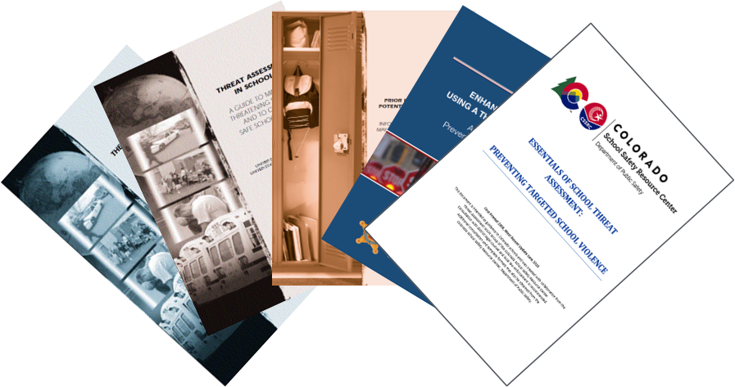
The Final Report and Findings of the Safe School Initiative
SAFE SCHOOL INITIATIVE REPORT FINDINGS
Conducted by the US Secret Service and Department of Education
Patterned after the Secret Service's Exceptional Case Study Project (ECSP)
Essentials of School Threat Assessment (CSSRC) based on the Safe School Initiative
Latest report from the US Secret Service released in 2023
Notes:
Speaking Notes:
Safe School Initiative is the foundation of threat assessment work conducted throughout the United States. It is the outcome of the collaboration between the US Secret Service and the Department of Education and reveals the key findings regarding incidents of students who threatened targeted violence.
The collaboration is patterned after the Secret Service’s Exceptional Case Study Project examining the lives of individuals who have carried out or tried to carry out lethal attacks on public officials.
All four documents are on your thumb drives and can be reviewed at your leisure, along with the most recent version of the CSSRC Essentials of School Threat Assessment resource guide.
Key findings are themes that are consistent across many incidents of targeted school violence and have stayed consistent from the earliest studies up through the most recent (2018)
Presenter Notes:
References: None
Image: None

Slide 16
Safe School Initiative Key Findings
SECRET SERVICE REPORT FINDINGS
SAFE SCHOOL INITIATIVE REPORT FINDINGS
Rarely sudden, impulsive acts.
Most attackers did not threaten their targets directly prior to advancing the attack.
15
Notes:
Speaking Notes: There is often some level of planning that goes into targeted acts of violence. FBI 2018 study found average of two weeks of planning and two weeks of preparation, such as gathering resources and weapons. That could be one day or one year. A student pushed against a locker and pulls out a pocket knife may seem reactionary and impulsive, but if the student was carrying a knife, they may have given thought to using it.
The second key finding works two ways. The threat itself may not be direct and explicit. There are different types of threats that will be covered in detail later. We also know that there can be time between the threat and the act, so the individual may make a threat and not follow through on it for days, weeks, or months later.
Presenter Notes:
References:
15. Vossekuil, B., Fein, R., Reddy, M., Borum, R., & Modzeleski, W., The Final Report and Findings of the Safe School Initiative: Implications for the Prevention of School Attacks in the United States. U.S. Department of Education, Office of Elementary and Secondary Education, Safe and Drug-Free Schools Program and U.S. Secret Service, National Threat Assessment Center, Washington, D.C., 2002. Revised 2004.
Image:
Shutterstock
Close up photo-real illustration of a computer keyboard with an orange, glowing question key surrounded by white question mark keys.
By Mark Carrel

Slide 17
SECRET SERVICE REPORT FINDINGS
SAFE SCHOOL INITIATIVE REPORT FINDINGS
Most attackers engaged in some behavior prior to the incident that caused others concern or indicated a need for help.
15
Notes:
Speaking Notes: There are behaviors of concern, or warning signs, that are often present. These will be covered in more detail later.
Presenter Notes:
References:
15. Vossekuil, B., Fein, R., Reddy, M., Borum, R., & Modzeleski, W., The Final Report and Findings of the Safe School Initiative: Implications for the Prevention of School Attacks in the United States. U.S. Department of Education, Office of Elementary and Secondary Education, Safe and Drug-Free Schools Program and U.S. Secret Service, National Threat Assessment Center, Washington, D.C., 2002. Revised 2004.
Image:

Slide 18
SECRET SERVICE REPORT FINDINGS
SAFE SCHOOL INITIATIVE REPORT FINDINGS
There is no accurate or useful “profile”
15
Notes:
Speaking Notes:
As a result of the Safe School Initiative, it is known that there is no accurate or useful profile of a “school shooter.” Research shows the students involved in school shootings from 1997 through 2000 had virtually nothing in common except that they were all male and involved in an act of targeted violence.
Implications: Focus on behaviors and communications that may indicate that a student poses a threat, or is serious about acting on a threat.
Implication: Most students who fit profiles won't pose a risk; profiling will fail to identify students who do pose a risk of violence.
Profile is used here to indicate demographics, not behaviors.
Presenter Notes:
Targeted school violence is described as the end result of a knowable and understandable thought process, not predicted by ‘traits’ or a profile. Many media reports tried to profile all school shooters as Trench Coat Mafia.
(Following the Columbine tragedy, there were reports circulated by the media that threatening students followed the philosophy, behavioral tenets, dress particular to the Trench Coat Mafia.)
Range of some facts about students who have engaged in targeted school violence:
Ages range from 11-21.
Come from a variety of racial and ethnic backgrounds.
Academic performance ranged from excellent to failing.
Range of friendship patterns—popular to isolated.
No observed behavior problems to multiple problems.
Few diagnosed with a mental disorder prior to attacks.
References:
15. Vossekuil, B., Fein, R., Reddy, M., Borum, R., & Modzeleski, W., The Final Report and Findings of the Safe School Initiative: Implications for the Prevention of School Attacks in the United States. U.S. Department of Education, Office of Elementary and Secondary Education, Safe and Drug-Free Schools Program and U.S. Secret Service, National Threat Assessment Center, Washington, D.C., 2002. Revised 2004.
Image:
Image by <a href="https://pixabay.com/users/OpenClipart-Vectors-30363/?utm_source=link-attribution&amp;utm_medium=referral&amp;utm_campaign=image&amp;utm_content=2025467">OpenClipart-Vectors</a> from <a href="https://pixabay.com/?utm_source=link-attribution&amp;utm_medium=referral&amp;utm_campaign=image&amp;utm_content=2025467">Pixabay</a>

Slide 19
SAFE SCHOOL INITIATIVE REPORT FINDINGS
Many attackers felt bullied, persecuted, or injured by others prior to the attack.
15
Notes:
Speaking Notes: A lot of conflict happens in schools, and the line between normal conflict and bullying has been blurred. We may overlook or minimize what we are seeing because students and parents perceive most conflict as bullying. What is important is the student’s own perception of the conflict. If they believe they are being bullied, harassed, picked on, or targeted, it can negatively impact the way they interact with their peers and school staff. During the inquiry process, it is important to get a sense of the student’s perception of situations, not just rely on what we think is going on.
Presenter Notes:
References:
15. Vossekuil, B., Fein, R., Reddy, M., Borum, R., & Modzeleski, W., The Final Report and Findings of the Safe School Initiative: Implications for the Prevention of School Attacks in the United States. U.S. Department of Education, Office of Elementary and Secondary Education, Safe and Drug-Free Schools Program and U.S. Secret Service, National Threat Assessment Center, Washington, D.C., 2002. Revised 2004.
Image:
Image by <a href="https://pixabay.com/users/johnhain-352999/?utm_source=link-attribution&amp;utm_medium=referral&amp;utm_campaign=image&amp;utm_content=655659">John Hain</a> from <a href="https://pixabay.com/?utm_source=link-attribution&amp;utm_medium=referral&amp;utm_campaign=image&amp;utm_content=655659">Pixabay</a>

Slide 20
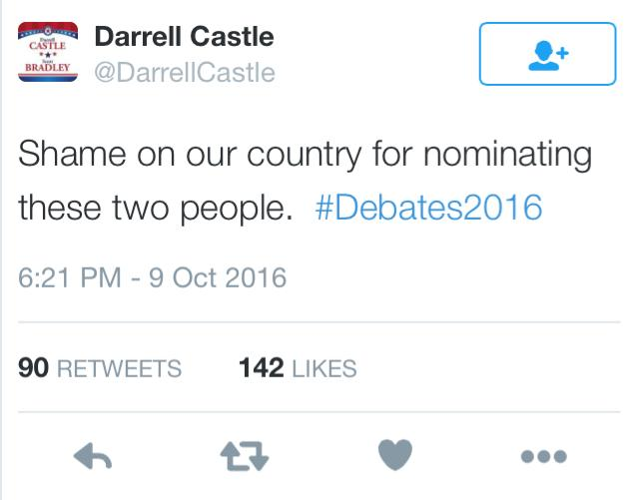
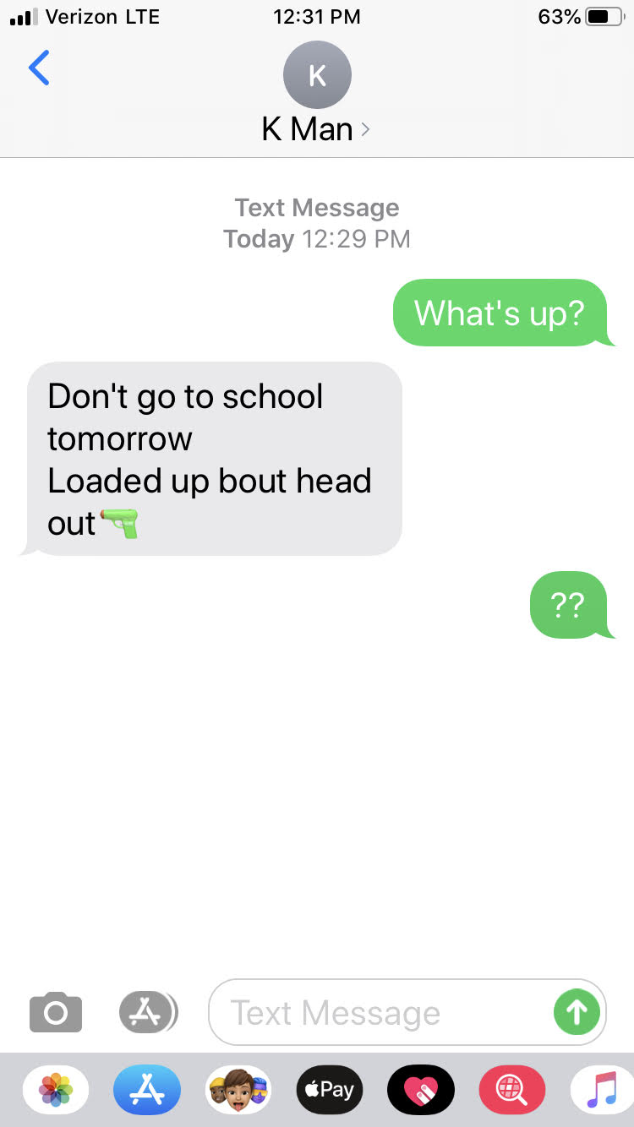
SAFE SCHOOL INITIATIVE REPORT FINDINGS
Prior to most incidents, other people knew about the attacker’s idea and/or plan to attack. (leakage or broadcasting)
shooting up the school tomorrow
wear a red shirt if you want to live so we know not to shoot you
On Feb. 23 @ 12:00 I am going to blow sh** up!
15
Notes:
Speaking Notes: In many cases, some sort of statement was made that indicated the student was considering a plan of targeted school violence. These statements can be made verbally, in writing such as school assignments, or on social media.
Presenter Notes:
In 75+% of the incidents someone knew about attacks before they occurred. Students who are in the planning stages of acts of targeted violence often ‘leak’ elements of their plans to others or through their academic assignments, or other representations of what they stand for, i.e. posters, websites.
Implications: All students in the student body must be part of prevention efforts. Teach all students what information should be reported. When a situation is reported, seek information from anyone in contact with potentially threatening student.
References:
15. Vossekuil, B., Fein, R., Reddy, M., Borum, R., & Modzeleski, W., The Final Report and Findings of the Safe School Initiative: Implications for the Prevention of School Attacks in the United States. U.S. Department of Education, Office of Elementary and Secondary Education, Safe and Drug-Free Schools Program and U.S. Secret Service, National Threat Assessment Center, Washington, D.C., 2002. Revised 2004.
Image:

Slide 21
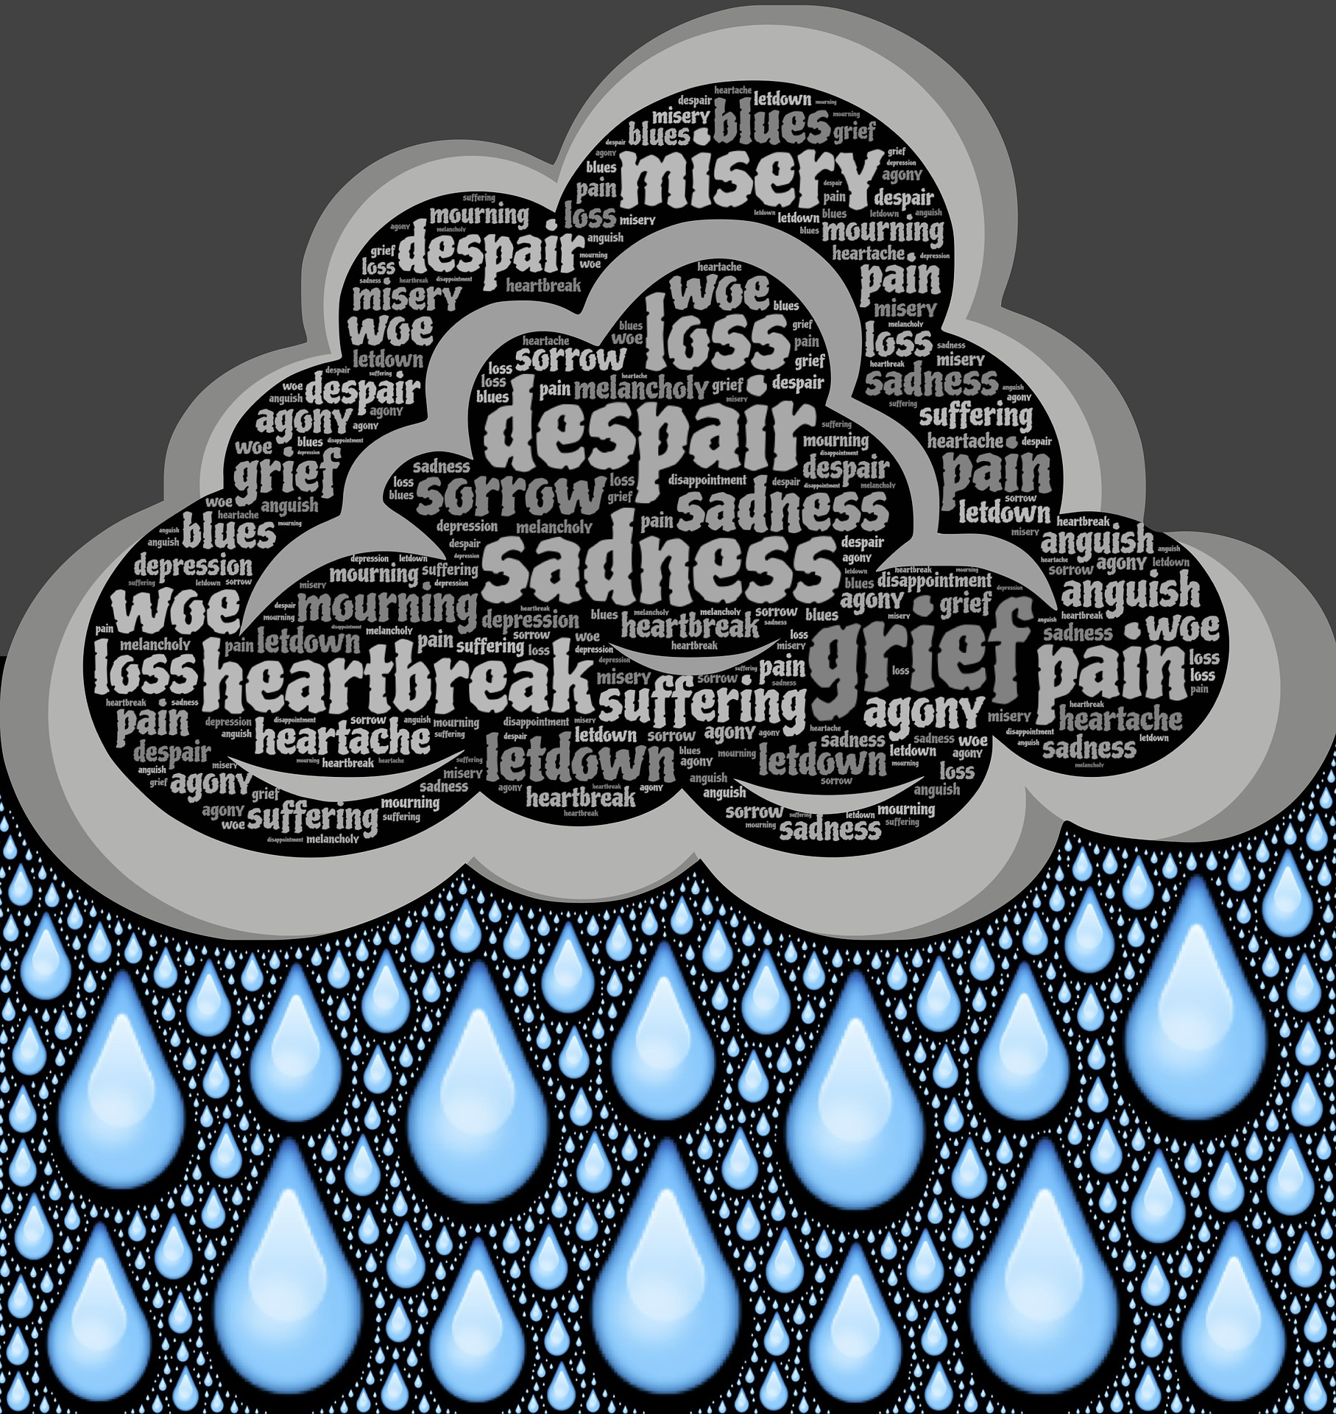
SAFE SCHOOL INITIATIVE REPORT FINDINGS
Most attackers had difficulty coping with significant losses or personal failures.
Moreover, many had considered or attempted suicide.
Table discussion: Suicide prevention.
15
Notes:
Speaking Notes: Individual losses and personal failures are also dependent upon the student’s perception. A pet dying may not seem like a big deal, but it could be the most important relationship they have. It is important to ask about what is going on in the student’s life that may be impacting the likelihood that they may carry out their plan. The FBI calls these stressors.
Presenter Notes:
Implications: assess a student for difficulty coping, personal failures, feelings of desperation, efforts to acquire weapons. Ask parents/guardians about access to weapons. Be willing to address talking with them about safe storage of weapons.
References:
15. Vossekuil, B., Fein, R., Reddy, M., Borum, R., & Modzeleski, W., The Final Report and Findings of the Safe School Initiative: Implications for the Prevention of School Attacks in the United States. U.S. Department of Education, Office of Elementary and Secondary Education, Safe and Drug-Free Schools Program and U.S. Secret Service, National Threat Assessment Center, Washington, D.C., 2002. Revised 2004.
Image:
Image by <a href="https://pixabay.com/users/johnhain-352999/?utm_source=link-attribution&amp;utm_medium=referral&amp;utm_campaign=image&amp;utm_content=717439">John Hain</a> from <a href="https://pixabay.com/?utm_source=link-attribution&amp;utm_medium=referral&amp;utm_campaign=image&amp;utm_content=717439">Pixabay</a>

Slide 22
SAFE SCHOOL INITIATIVE REPORT FINDINGS
Most attackers had difficulty coping with significant losses or personal failures.
Moreover, many had considered or attempted suicide.
15
Notes:
Speaking Notes: Individual losses and personal failures are also dependent upon the student’s perception. A pet dying may not seem like a big deal, but it could be the most important relationship they have. It is important to ask about what is going on in the student’s life that may be impacting the likelihood that they may carry out their plan. The FBI calls these stressors.
Presenter Notes:
Implications: assess a student for difficulty coping, personal failures, feelings of desperation, efforts to acquire weapons. Ask parents/guardians about access to weapons. Be willing to address talking with them about safe storage of weapons.
References:
15. Vossekuil, B., Fein, R., Reddy, M., Borum, R., & Modzeleski, W., The Final Report and Findings of the Safe School Initiative: Implications for the Prevention of School Attacks in the United States. U.S. Department of Education, Office of Elementary and Secondary Education, Safe and Drug-Free Schools Program and U.S. Secret Service, National Threat Assessment Center, Washington, D.C., 2002. Revised 2004.
Image:
Image by <a href="https://pixabay.com/users/johnhain-352999/?utm_source=link-attribution&amp;utm_medium=referral&amp;utm_campaign=image&amp;utm_content=717439">John Hain</a> from <a href="https://pixabay.com/?utm_source=link-attribution&amp;utm_medium=referral&amp;utm_campaign=image&amp;utm_content=717439">Pixabay</a>

Slide 23
SAFE SCHOOL INITIATIVE REPORT FINDINGS
Most attackers had access to and had used weapons prior to the attack.
Vast majority get weapons from their own home.
5, 15
Notes:
Speaking Notes: Most research and examples are based on school shootings, but it is important to think about other types of weapons, such as edged weapons, explosives, cars, etc. Ask the student about what is involved in their specific plan and discuss ways to limit access to those means. Parents can be very helpful in this conversation as well. FBI study (2013?) found that about 75% of young people had access to weapons within their own homes, rather than obtaining them illegally or from friends, etc.
Presenter Notes:
Implications: assess a student for difficulty coping, personal failures, feelings of desperation, efforts to acquire weapons. Ask parents/guardians about access to weapons. Be willing to address talking with them about safe storage of weapons
References:
5. Langman, Peter, and Frank Straub. 2019. A Comparison of Averted and Completed School Attacks from the Police Foundation Averted School Violence Database. Washington, DC: Office of Community Oriented Policing Services.
15. Vossekuil, B., Fein, R., Reddy, M., Borum, R., & Modzeleski, W., The Final Report and Findings of the Safe School Initiative: Implications for the Prevention of School Attacks in the United States. U.S. Department of Education, Office of Elementary and Secondary Education, Safe and Drug-Free Schools Program and U.S. Secret Service, National Threat Assessment Center, Washington, D.C., 2002. Revised 2004.
Image:
https://www.shutterstock.com/image-illustration/gun-safe-on-white-background-359338886

Slide 24
SAFE SCHOOL INITIATIVE REPORT FINDINGS
In many cases, other students were involved in some capacity.
15
Notes:
Speaking Notes: Some cases where other students were involved. Examples include Columbine, in which an older friend purchased weapons for the two students, who were not yet of age, and a case in Alaska in which one student taught another how to load and operate a firearm and others watched and recorded the shooting when it occurred. Important to interview friends, classmates, etc. who may have heard leakage or broadcasting or may have even been involved in the planning or preparation for the attack.
Presenter Notes:
References:
15. Vossekuil, B., Fein, R., Reddy, M., Borum, R., & Modzeleski, W., The Final Report and Findings of the Safe School Initiative: Implications for the Prevention of School Attacks in the United States. U.S. Department of Education, Office of Elementary and Secondary Education, Safe and Drug-Free Schools Program and U.S. Secret Service, National Threat Assessment Center, Washington, D.C., 2002. Revised 2004.
Image:
Image by <a href="https://pixabay.com/users/geralt-9301/?utm_source=link-attribution&amp;utm_medium=referral&amp;utm_campaign=image&amp;utm_content=2814937">Gerd Altmann</a> from <a href="https://pixabay.com/?utm_source=link-attribution&amp;utm_medium=referral&amp;utm_campaign=image&amp;utm_content=2814937">Pixabay</a>

Slide 25
SAFE SCHOOL INITIATIVE REPORT FINDINGS
Despite prompt law enforcement responses, most shooting incidents were stopped by means other than law enforcement intervention.
15
Notes:
Speaking Notes: This may sound like a Run, Hide, Fight situation, which we believe can be a helpful training among many other school safety options. We like to emphasize other prevention and mitigation strategies, such as a TA process, good response protocol, and communication and relationships with emergency responders to make sure they know what your lockdown and evacuation procedures look like, they know what to expect if they need to respond, and they can be on the same page with your response plans.
Presenter Notes:
The average active-shooter incident lasts 12 minutes. Thirty-seven percent last less than 5 minutes.¹¹
Overwhelmingly, the offender is a single shooter (98 percent), primarily male (97 percent). In 40 percent of the instances, they kill themselves.¹²
Two percent of the shooters bring IEDs as an additional weapon.¹³
In 10 percent of the cases, the shooter stops and walks away. In 20 percent of the cases, the shooter goes mobile, moving to another location.¹⁴
Forty-three percent of the time, the crime is over before police arrive. In 57 percent of the shootings, an officer arrives while the shooting is still underway.¹⁵
The shooter often stops as soon as he hears or sees law enforcement, sometimes turning his anger or aggression on law enforcement.¹⁶
References:
15. Vossekuil, B., Fein, R., Reddy, M., Borum, R., & Modzeleski, W., The Final Report and Findings of the Safe School Initiative: Implications for the Prevention of School Attacks in the United States. U.S. Department of Education, Office of Elementary and Secondary Education, Safe and Drug-Free Schools Program and U.S. Secret Service, National Threat Assessment Center, Washington, D.C., 2002. Revised 2004.
Image:
Image by <a href="https://pixabay.com/photos/?utm_source=link-attribution&amp;utm_medium=referral&amp;utm_campaign=image&amp;utm_content=1031503">Free-Photos</a> from <a href="https://pixabay.com/?utm_source=link-attribution&amp;utm_medium=referral&amp;utm_campaign=image&amp;utm_content=1031503">Pixabay</a>

Slide 26
SAFE SCHOOL INITIATIVE REPORT FINDINGS
Implications for Prevention
Many incidents of school violence can be prevented
Information about a subject’s ideas and plans for violence can be observed or discovered before harm can occur
Information available is likely to be scattered and fragmented
It is key to act quickly upon an initial report of concern, gather other pieces of the puzzle, then assemble to see what picture emerges
Notes:
Speaking Notes: The take-home message from all of this is that many school shootings and other acts of targeted violence are preventable – if we can uncover someone’s ideas and plans for violence in advance.
The challenge is that while there are usually pieces of the puzzle available, the information is likely to be scattered and fragmented.
If we can act quickly when we first learn about someone who has raised concern, we can figure out who might have some relevant information – a piece of the puzzle – and start assembling the facts.

Slide 27
SAFE SCHOOL INITIATIVE REPORT FINDINGS
Implications for Prevention
Most people who exhibit concerning behaviors (bullying, suicidal ideation, first episode psychosis, conduct disorders, trauma, diminished social skills) will never commit an act of extreme violence. However,
if you treat the concerning
behavior, you will likely
prevent potential
instances of future
violence. Effectively
dealing with the
concerning behaviors
also builds trust and
positive relationships.
Concerning Behavior
Commit Violence
Notes:
Speaking Notes: The small circle in the venn diagram would actually be too small to see if it were to scale, but it is enlarged in order to visualize the intersection. Only an extremely small ratio of those exhibiting any of the above-mentioned concerning behaviors will commit an act of extreme violence.

Slide 28
W H A T I S A T H R E A T ?
A threat is an expression of intent to do harm or act out violently against someone or something (spoken, written or symbolic).
Direct
Specific target
Clear and explicit
Veiled
Hints at an act
Interpretation needed
Indirect
Vague and unclear
Act could occur
Conditional
Certain conditions must be met
Designed to gain compliance
9
Notes:
Speaking Notes:
Here is our definition of what a threat is, you may see them in spoken, written or symbolic expressions. Symbolic may be the classic finger gun or a throat cutting gesture. In the written or spoken we will typically see four types.
The first is direct, this is a slam dunk for threat assessment teams, because the threat is very clear, specific and has the beginnings of a plan such as an identified target, weapon type, times, dates and locations. This is also the most likely to be reported, because of the explicit manner.
The second type is indirect, this is much harder to get reported, because the intent is not as clear, its vague in nature. The student is letting the listener know that they have thought about a plan or gained some skills or knowledge necessary to carry out an attack. An example is the UT tower shooter from the 60’s, he was walking through the quad near the tower weeks before the attack and mentioned, “A guy could hold off an army from up there.” He didn’t say he was going to kill people, just that he had thought thru how to conduct an attack. Or, you may have a student come back from summer vacation and mention, “I learned how to make explosives over the summer.” Again, not saying the will blow up the school, but that they have gained the knowledge necessary to do something.
The third type is veiled, where the student hints at an attack and wants the listener to be aware and perhaps so the listener can take protective measures to avoid the attack. This type of threat will likely be shared with a close friend, loved one or staff member that the student wants to keep safe. Like, “Don’t come to school tomorrow, bad things are going to happen.” Again not that they are going to conduct a shooting, but that bad things may happen. Or, in the social media post we saw earlier, “Wear red tomorrow, so we know not to shoot you.” A personal warning, so their friends will be safe during the attack This type is hard to get students to report, because they feel like there is trust between them and the attacker.
And finally we have the conditional threat, again likely given to a friend or trusted acquaintance letting the listener know that unless conditions are met, an attack may happen, for instance, “Go with me to the dance or people will die.” Or perhaps the attacker has communicated something scary and the listener feels the need to report this, the attacker may grow defensive and say something like, “If you tell, I’ll make sure you’re the first to go.”
Presenter Notes:
Threats of targeted violence can appear in many forms in schools.
Symbolic ex: pointing your finger at someone and pulling the trigger, slicing your throat with your finger
17% of threats are direct
References:
9. O'Toole, M. (1999). The school shooter: A threat assessment perspective. Federal Bureau of Investigation. https://files.eric.ed.gov/fulltext/ED446352.pdf
Image:

Slide 29
W H A T I S A T H R E A T ?
Assessing Written or Artistic Material
Understand the context of the writing or drawing
Assignment
Peers
Age group
Look for themes
Monitor past and future materials
Think of written and artistic material as attempts to practice violence.
5
Notes:
Speaking Notes:
Here is your cheat sheet when evaluating written or artistic materials. The first thing to understand is the context of the materials, did the teacher inadvertently ask for violent or dark materials, perhaps an assignment around Halloween or on Edgar Allan Poe, Stephen King, M. Night Shyamalan. So look at what was turned in by other students from the same class and age group. An example is the Virginia Tech shooter who was asked to write about doing something, other students turned in papers on making a sandwich, fixing a carburetor, or making their bed, the shooter wrote about killing his stepfather, decapitating him, placing a cell phone in the body, burying the body and calling the cellphone to see if he could hear it ring. That is way outside of the norm for that assignment.
When speaking to a student about these materials you will want to express concern, look for themes throughout other classes and assignments, ask for details (Why did you write this? Looking for details of a plan, always talk about knowledge and access to weapons, be persistent when conducting this part of the interview, be on the lookout for non-verbal cues such as looking away, sweating, dissembling. (This is why it’s important to conduct the interview with two team members so one can watch the student as they are being interviewed for cues, also to take notes and for safety considerations.) Also monitor past and future materials to look for a pattern of behavior or perhaps the material is a one off around Halloween, which may be normal behavior. Finally think of these materials as practice attempts, if they can write or draw about violence, perhaps they can move closer to carrying out the attack
One additional note for teachers, if they find these materials they should report them to the TA team and not return them to the student with a grade, the English professor at Virginia Tech returned the writing referenced earlier with an “A++, Great Job!”. She was not commenting on the content but on the penmanship, grammar and punctuation, but may have inadvertently shown approval of the attack to the shooter, pushing him closer to violence.
Presenter Notes:
Break down the details. Quote and reference the material without judgment or leading questions. Model concern when something is upsetting or bizarre. These are representations of practicing behaviors. Enter their fantasies and give them a realistic perspective on what it means to an outsider.
Understand the context of the writing or drawing
Outside the norm for that assignment, student’s peers, age group, etc.
Express concern to the student
Look for themes
Ask in detail about the material
Be persistent and specific with questions
Assess access to, or knowledge of, weapons
Watch for non-verbal cues
Monitor past and future materials
Think of written and artistic material as attempts to practice violence
References:
5. Kanan, L. & Lee, R. (2005). Threat Assessment Conference presentation conducted at the meeting of the Cherry Creek School District. Aurora, Colorado.
Image:
https://www.google.com/url?q=https://www.shutterstock.com/image-photo/artistic-equipment-easel-paint-brushes-tubes-613446836&sa=D&source=hangouts&ust=1579213171414000&usg=AFQjCNFhLi8fDho0PHlq8ggsmwm_UoLggw

Slide 30
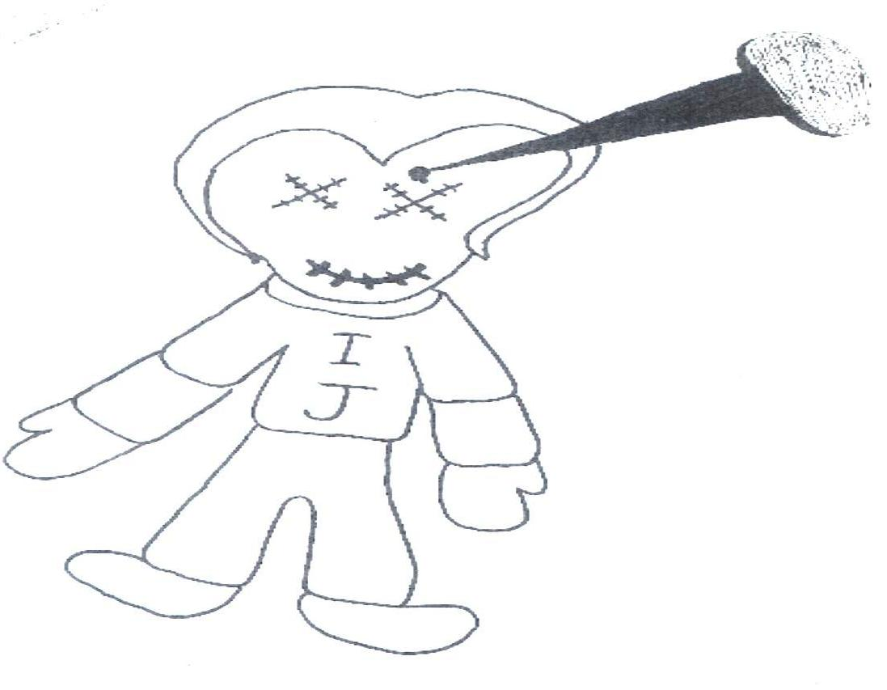
W H A T I S A T H R E A T ?
Drawings
-drawing by a 10th grader
Notes:
Speaking Notes:
Note that drawings are typically seen with younger children, because they are not as able to express themselves in written/verbal communications.
Mention context, this drawing may be somewhat normalized if teacher is instructing on Voodoo culture
Ask group to read this writing and think about the key findings and behaviors of concern
Have group identify key points or summarize if necessary:
Initials, may indicate an identified target or suicidal ideation if they match the student’s initials
Sewn shut eyes and mouth, may indicate death or silencing a snitch
Doll, may indicate dehumanization of actual target to a doll or a voodoo doll
Spike in head, may indicate type of weapon, violence and/or voodoo connection. Also, note that spike is very detailed, compared to doll, may indicate obsession
Presenter Notes:
Drawing by 10th grader
Artwork left on another student’s desk after class was dismissed.
References:
None
Image:
Provided by L. Kanan

Slide 31
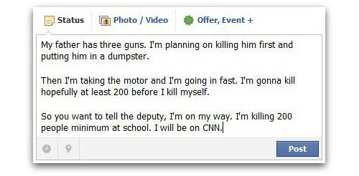
W H A T I S A T H R E A T ?
Writings & Social Media Posts
Notes:
Speaking Notes:
Ask group to read this writing and think about the key findings and behaviors of concern
Have group identify key points or summarize if necessary:
Specific number indicates research and planning, may indicate obsessing over number of targets
Entire writing is a plan
“Has three guns”, may indicate student has access to weapons
“Killing him first and putting him in dumpster”, may indicate desensitizing or practicing violence on father, dehumanization because father is a piece of garbage, eliminating barriers to the planned for attack on the school
“Taking the motor”, may indicate a different weapon type to be used in killing targets
“I kill myself”, may indicate suicidal ideation
“Tell the deputy”, may indicate desire to “suicide by cop”
“Be on CNN”, may indicate desire for infamy and/or the presence of a legacy token
Presenter Notes:
References:
None
Image:
Provided by L. Kanan

Slide 32
W H A T I S A T H R E A T ?
Making vs. Posing a Threat
Some who make threats ultimately pose threats
Many who make threats do not pose threats
Some who pose threats never make threats
Implication:
All threats must be taken seriously
Threats are not a necessary condition to initiate an inquiry or preliminary evaluation
Notes:
Speaking Notes:
Many students will make regular threats, due to disabiity or youth, but lack the capacity to actually carry something out.
Some will never communicate a threat, based on isolation or an ability to keep secrets, but if they are exhibiting behaviors of concern, they should still be assessed. You don’t have to have a threat to conduct a threat assessment, although it’s in the name.
The implication is that, while all threats (direct, indirect, conditional, or otherwise) should be taken seriously, they are not the most reliable indicator of risk for violent behavior and, therefore, should not be a necessary condition to initiate an inquiry or assessment.
A Threat Assessment team will, ideally, be called together when there is a concern that a student could pose a threat. If possible, do not wait until the student actually makes a threat.
Presenter Notes:
References:
Image:
None

Slide 33
When to Implement the Threat Assessment Process
Notes:
Speaking Notes: Just covered why we do Threat Assessments, now lets cover when this process should be implemented. As we explore these behaviors, be thinking about where a student may be on the pathway to violence.
Presenter Notes:
Introducing the next section.
References:
None
Image:
None

Slide 34
WHEN TO IMPLEMENT THE PROCESS
Behaviors & Circumstances of Concern
Current Life Information
“Downward” progression in functioning/relationships and coping
Hopelessness, desperation, and/or despair
Pending/recent crises
Recent losses or loss of status
Perception of being treated unfairly
Social networks
Be aware of changes in, and clusters of, these behaviors.
Notes:
Speaking Notes:
You will remember that earlier in this presentation, it was mentioned that students who pose a threat of targeted violence often engaged in behavior that was of concern to others or seemed to be indicative of a need for intervention.
Motives: You will see here a selection of possible motives for launching an attack, Dr. Nicoletti has focused most of his work on the “avenger killer” who is looking to avenge some perceived wrong that has been committed against them.
Current Life Information: Downward progression in functioning may be academic changes, inability to cope with stress, a downward progression in relationships with friends, family, boyfriend/girlfriend. Perception of being treated unfairly it is important as was mentioned earlier, it is the students perception not ours as adults. Example is the Columbine shooters; after their attack the media and society stated that they had to have been bullied to conduct such a heinous attack, but witness statements from the school community did not report this, in fact they reported in some cases that the shooters were the bullies, but if you go one step deeper and read the shooters personal journals, the shooter perceived that they were being harassed, bullied and isolated from the greater school community based on the way they dressed, their personal appearance, and the music they listened to.
Remember that the most important thing maybe that we are seeing a change in behaviors or clusters (groups) of these behaviors in a very short period of time. The Virginia Tech shooter exhibited 22 warning signs in the two weeks prior to his attack, which were unfortunately not tied together until after the attack.
Many of your students may have some of these behaviors or circumstances, you need to establish if this is their baseline, not that its great they have them, but at minimum we can observe if they are collecting additional behaviors and/or are experiencing changes.
Presenter Notes:
Complete list can be found in Essentials and on one pager
References:
3. Federal Bureau of Investigation Behavioral Analysis Unit. (2018). The school shooter – A quick reference guide. https://info.publicintelligence.net/FBISchoolShooterReferenceGuide.pdf
4. Fein, R., Vossekuil, B., Pollack, W., Borum, R., Modzeleski, W., & Reddy, M. Threat Assessment in Schools: A Guide to Managing Threatening Situations and to Creating Safe School Climates. U.S. Department of Education, Office of Elementary and Secondary Education, Safe and Drug-Free Schools Program and U.S. Secret Service, National Threat Assessment Center, Washington, D.C., 2002.
National Threat Assessment Center. (2018). Enhancing school safety using a threat assessment model: An operational guide for preventing targeted school violence. U.S. Secret Service, Department of Homeland Security.
Image:
Image by <a href="https://pixabay.com/users/geralt-9301/?utm_source=link-attribution&amp;utm_medium=referral&amp;utm_campaign=image&amp;utm_content=663368">Gerd Altmann</a> from <a href="https://pixabay.com/?utm_source=link-attribution&amp;utm_medium=referral&amp;utm_campaign=image&amp;utm_content=663368">Pixabay</a>

Slide 35
WHEN TO IMPLEMENT THE PROCESS
Behaviors & Circumstances of Concern
Attack-Related
Attack plans, boundary probing or rehearsals
Unusual interest in school attacks
Recent weapon-seeking behavior
Condones or is considering violence
Inappropriate or dramatic change in appearance
Abrupt cessation in the use of alcohol, drugs, and/or medications
Creation of a legacy token
Pre-attack staging or cocooning
Notes:
Speaking Notes:
Moving further up the pathway to violence we may begin to see attack related behaviors prior to an attack; such as skill set building or gaining the needed tactical plan or experience, gathering weapons and other tactical gear needed for the attack, dehumanizing of the target(s) through name calling and desensitization by practicing violence perhaps on small animals, siblings or family members, changes in appearance like those seen in the Aurora theater shooter and the Virginia Tech shooter, we may also see those who use alcohol, drugs or medications stop using so they can think more clearly and carry out their plan. Additionally, moving even further up the pathway to violence we may see the creation of a “legacy token” which may be a video or written manifesto examples of this include the Parkland, Virginia Tech and Isla Vista shooter. And, finally we may see “cocooning” or self isolation so they can make final preparations, as was seen in the Sandy Hook shooter.
Presenter Notes:
Don’t have to mention every one, pick the ones that the presenter feels the most comfortable with.
Complete list can be found in Essentials and on one pager
Other ways to explain:
Attack plans, boundary probing or rehearsals (skill set building)
Recent weapon-seeking behavior (and/or other tactical paraphernalia)
Condones or is considering violence (dehumanization & desensitization)
Abrupt cessation in the use of alcohol, drugs, and/or medications (cleansing/purifying)
Inappropriate or dramatic change in appearance (e.g. hair, tattoos)
References:
3. Federal Bureau of Investigation Behavioral Analysis Unit. (2018). The school shooter – A quick reference guide. https://info.publicintelligence.net/FBI-SchoolShooterReferenceGuide.pdf
4. Fein, R., Vossekuil, B., Pollack, W., Borum, R., Modzeleski, W., & Reddy, M. Threat Assessment in Schools: A Guide to Managing Threatening Situations and to Creating Safe School Climates. U.S. Department of Education, Office of Elementary and Secondary Education, Safe and Drug-Free Schools Program and U.S. Secret Service, National Threat Assessment Center, Washington, D.C., 2002.
6. National Threat Assessment Center. (2018). Enhancing school safety using a threat assessment model: An operational guide for preventing targeted school violence. U.S. Secret Service, Department of Homeland Security.
8. Nicoletti, J. (2013, April 12). Detection, disruption & threat assessment in schools. [Conference session.] Symposium conducted at the meeting of the Colorado School Safety Resource Center, Loveland, Colorado. http://cdpsdocs.state.co.us/safeschools/Training%20Flyers%20Agendas/Nicoletti%20CSSRC%20Threat%20Assessment%20in%20Schools%20Training.CSSRC.pdf.
Image:
None

Slide 36
PREREQUISITES: LEGAL, POLICY, & KEY STEPS
Legal Considerations
Family Educational Rights and Privacy Act (FERPA)
Health Insurance Portability and Accountability Act (HIPAA)
Information Sharing Statutes
Claire Davis School Safety Act (Colorado Senate Bill)
Notes:
Speaking Notes: Introduction of topics covered in the first half of prerequisites
Presenter Notes:
References:
None
Image:
None

Slide 37
PREREQUISITES: LEGAL, POLICY, & KEY STEPS
FERPA
May disclose information to appropriate parties when knowledge of the information is necessary to protect the health and safety of a student or other individual, if there is a significant and articulable threat to the health and safety of an individual.
Information covered by FERPA can be disclosed to school staff who has legitimate interests in the behavior of that student.
Such information can be disclosed to staff of another school who have legitimate educational interests in the behavior of that student.
2, 13
Notes:
Speaking Notes: In some cases, staff didn’t share information they had about concerning behaviors or threats because they believe FERPA prohibited them from doing so. Information overheard or observed (social media, conversations) are not covered by FERPA anyway. The 2008 exception (second bullet point) allows for sharing of concerns even when they are covered by FERPA. The fourth bullet point allows that information sharing only with school staff who will come into contact or work with that student, or help supervise them. So not everyone on the staff needs to be notified and those who are don’t need every detail. Only those who need to know and only what they need to know to help support and supervise.
Presenter Notes:
During the conversation about school staff, ask about SROs or community mental health partners and how information is shared with them. MOUs can be written to say they are “school staff for the purposes of information sharing” to allow access to Infinite Campus, PowerSchool, etc. This was not the case in Arapahoe HS and the SRO did not have all necessary information.
2000 Exception: Educational Agencies and Institutions may share information from educational records of at-risk or delinquent youth.
2008 Exception: May disclose information to appropriate parties when knowledge of the information is necessary to protect the health and safety of a student or other individual, if there is a significant and articulable threat to the health and safety of an individual
June, 2010: Directory information may be disclosed to an emergency agency trying to locate parents/guardians
Information covered by FERPA can be disclosed to school staff who have legitimate interests in the behavior of that student. Sec 99.36(b)2
Such information can be disclosed to staff of another school who have legitimate educational interests in the behavior of that student. Sec 99.36 (b)3
The Colorado Office of the Attorney General has guidance on this for schools. Please check resources attached.
Also ask about information sharing with other schools/districts when students transfer out or in. This is a weakness everywhere, so encourage reviewing their process for when and how to send information and when and how to request it.
This conversation can take some time, but is usually needed.
Many misconceptions about FERPA and student information
1994 Amendments to FERPA:
Allows schools to pass along disciplinary information for conduct that poses a significant risk to safety of others to those who have legitimate interest in behavior of the student.
2000 exception – at-risk, delinquent youth info can be shared to others
References:
2. Coffman, C.H., (2018). Formal Opinion No. 18-01. State of Colorado Department of Law https://www.cde.state.co.us/dataprivacyandsecurity/ag-ferpaandschoolsafety
13. United States Department of Education, Readiness and Emergency Management for Schools Technical Assistance Center. (2011). Addressing emergencies on campus. rems.ed.gov/docs/ED_AddressingEmergenciesOnCampus.pdf
Image:
None

Slide 38
PREREQUISITES: LEGAL, POLICY, & KEY STEPS
FERPA and HIPAA
Most student records are covered by FERPA
Mental health professionals who are working in the school are usually covered by FERPA when they are:
Employed by the school
Contracted by the school and maintain their records in a school database
HIPAA does not usually apply to schools, because any health information collected by an educational institution is considered an educational record under FERPA.
Missouri’s AG Office has not provided specific guidance. The Colorado AG’s Office has said, “Educators should err on the side of safety. Neither a school nor a school employee can be sued for claimed violations of FERPA.”
When in doubt, check with your legal counsel.
12
Notes:
Speaking Notes:
Even if a school is a covered entity and must comply with the HIPAA Transactions and Code Sets Rules, the school would not be required to comply with the HIPAA Privacy Rule if it only maintains health information in FERPA “education records.” For example, a public high school might employ a health care provider that bills Medicaid electronically for services provided to a student under the IDEA. The school is a HIPAA covered entity because it engages in one of the covered transactions electronically, and therefore, would be subject to the HIPAA transaction standard requirements. However, if the school provider maintains health information only in “education records” under FERPA, the school is not required to comply with the HIPAA Privacy Rule because the Privacy Rule explicitly excludes FERPA “education records.”
Presenter Notes: Who is paying and where are the records kept?
Employee of the school, paid by the school, records kept in school database (e.g. Infinite Campus) = FERPA
Employee of community mental health, contracted and paid by the school = FERPA
Employee of community mental health paid by that agency but providing services within the school, records kept in school database = those records are FERPA
Employee of community mental health, paid by that agency, all records kept in agency databases = HIPAA
FERPA vs. HIPAA
Some confusion can arise when professionals (e.g., psychologist, psychiatrist, social worker), who normally works under HIPAA works with students on behalf of or as a consultant to the school, which is covered by FERPA.
First, HIPAA does *not* usually apply to schools, because any health information collected by an educational institution is considered an educational record under FERPA.
Second, the U.S. Departments of Education and Health and Human Services have explained that in emergencies and situations when an individual’s health is at risk, educational institutions and healthcare providers may disclose a student’s health information to other professionals or agencies to prevent harm.
Finally, because confusion about FERPA and HIPAA have played a role in prior school attacks, the U.S. Department of Education defers to school and health professionals on any decision to disclose student or patient information to prevent or address a threat to the health or safety of the individual or others.
The Colorado AG’s Office has said, “Educators should err on the side of safety. Neither a school nor a school employee can be sued for claimed violations of FERPA.”
The U.S. Secretary of Education Betsy DeVos has said, “Confusion on when records can be shared should not stand in the way of protecting students while they are in school.”
References:
12. United States Departments of Education & Health and Human Services. (2019, first issued 2008). Joint guidance on the application of the Family Educational Rights and Privacy Act (FERPA) and the Health Insurance Portability and Accountability Act of 1996 (HIPAA) to student health records.
studentprivacy.ed.gov/sites/default/files/resource_document/file/2019%20HIPAA%20FERPA%20Joint%20Guidance%20508.pdf
Image:
None

Slide 39
PREREQUISITES: LEGAL, POLICY, & KEY STEPS
Interaction with Parents/Guardians
Determine when and how to involve them
Provide a copy upon request
Consider policy stipulations regarding how to share (such as report redactions and summary reports) to avoid privacy violations or endangering witnesses
Ask about online presence and weapons access
Notes:
Speaking Notes:
Purpose of this process is to help their child and protect the safety of others
Colorado law: CRS 22-1-123 Parental permission is not necessary to conduct suicide and threat assessments, although they do have to be notified. When and how depends on the school/district and their relationship with the student and family on a case by case basis. Since their permission is not required to begin, if the family may disrupt the process, some information can technically be gathered before they are notified. But building rapport and engaging them in the process is still preferred when possible.
Parents can ask for and receive a copy of the entire completed Threat Assessment protocol. We recommend that teams lead with the summary documentation form. If parents still want the entire document, ensure that witnesses and other sensitive information has been redacted before providing this copy to parents. Also emphasize keeping the report professional, since parents and others may eventually see it.
The final box is a reminder that parents should be interviewed for many reasons, but can be extremely helpful in the areas of online presence, social media, search histories, and access to/options for securing weapons.
Presenter Notes:
References:
None
Image:
None

Slide 40
PREREQUISITES: LEGAL, POLICY, & KEY STEPS
Threat Assessment Policy Elements
Policy should:
Plan to identify and manage threatening behaviors
Grant authority and leadership
Develop and train multi-disciplinary team
Establish integrated systems relationships and partnerships
Provide awareness level training
Notes:
Speaking Notes:
1. Authority and leadership to conduct an inquiry
A formal policy and established procedures are recommended
District and building leadership must support the process and designate a team
Information sharing to establish a “vortex” of information must support the process and be vetted by legal professionals
Are these duties part of your job description?
Some school districts have written explicit policies on TA
2. Ongoing planning to develop and train a multi-disciplinary threat assessment team that is based in the school or school district
Existing teams may already be in place
Roles and responsibilities should be clearly defined
Leadership should be established
Train your team members together!
Use experiential exercises and tabletops like other drills and practice
3. Integrated systems relationships and partnerships must be established to respond to public safety concerns
Systems relationships AND individual relationship
Use “boundary spanners”
Using Interagency Social Support Teams (Colorado HB 00-1119)
Other integrated service or collaborative management teams (Colorado HB 04-1451)
4. Awareness training for staff, students, parents and community partners in the warning signs of violence and other dangerous behaviors and reporting procedures
Presenter Notes:
References:
CSSRC Essentials of Threat Assessment
Image:
None

Slide 41
How to Conduct a Risk Assessment
Notes:
Speaking Notes:
Now let’s transition from prerequisites or things that should be completed prior to conducting an assessment, to how we we will actually carry out the assessment and management of threatening behavior.
Presenter Notes:
References:
None
Image:
None

Slide 42
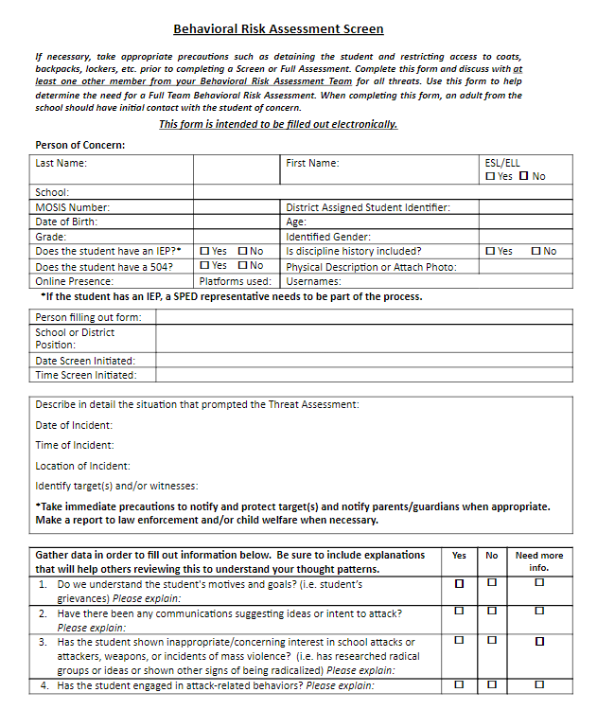
Notes:
Speaking Notes:
If you can all pull your copy of the assessment, either you’re digital or hard copy. This tool has been developed based on a tool originally produced by 5 of the school districts in Adams County, collectively called the Adams County Youth Initiative, under a federal grant. We also recently did a cross sectional analysis of 10 other tools and systems to ensure out tool includes many different aspects from these tools.
Introducing the screen: Once a threat has been reported to the team or you as a member of the team it is necessary to pull in at least one additional trained team member to complete the screen with all available information you may have as quickly as possible, this may necessitate ensuring the safety of the student of concern and interviewing them. We always recommend conducting this initial interview with the student of concern as soon as possible and with one additional trained member to watch for non verbal cues, take notes and as a security precaution. After gathering as much information as you can in a quick manner, the two persons conducting the screen will answer the 11 questions of the US Secret Service. Based on these answers they will determine if there is a need to gather additional information through a full team information, pull in additional trained personnel due to the severity of the threat in a full team assessment, a gut instinct that more information is out there which would point to the need for a full team assessment or that those completing the screen feel comfortable that they understand the situation and have the resources necessary to provide a safe environment for the student of concern and others. Remember that there is no math behind this screen, no 6 yes’ and 5 no’ is a good thing or 4 and 7 is bad, this tool helps you make a structured professional judgement, there is still an element of gut instinct in this work.
Let’s discuss the 11 questions that make up the screen and the tool.
Presenter Notes:
Walk attendees through different sections of the tool, by page #. Flow chart, screen, full team, team determination, RMS, summary documentation form and different interviews. Describe as necessary, but not in too much detail as we will go through this for the remainder of the training.
References:
None
Image:
CSSRC

Slide 43
HOW TO CONDUCT A RISK ASSESSMENT
Eleven Questions of the Secret Service
What are the student’s motives and goals? (Motives)
Have there been any communications suggesting ideas or intent to attack? (Communications)
Has the student shown inappropriate/concerning interest in: school attacks or attackers, weapons, incidents of mass violence? (Inappropriate Interests)
Has the student engaged in attack-related behaviors? (Planning)
Does the student have the capacity (resources or ability) to carry out an act of targeted violence? (Capacity)
Is there information to suggest that the student is experiencing hopelessness, desperation, or despair? (Desperation or Despair)
4, 7
Notes:
Speaking Notes:
Here you will see the 11 questions of the US Secret Service with the investigative themes included as well. You will note, that we never ask anyone else these 11 questions we ask the supporting questions found in the tool, interviews and Essentials Guide to assist the TA team in answering these questions.
The 1st question, what are the students motives and goals, is used to determine the students motives and goals, are they trying to scare people, get attention, right some wrong or simply not making good word choices and aren’t able to cope with frustrations. You can see here where it would not be terribly helpful to ask a 5ht grader, “What are your motives and goals?”, but some supporting questions like, “Why did you say that?, or What did you mean by that?”, would be more helpful
2nd question, has there been any communications suggesting ideas or intent to attack is used to help identify if the student has been broadcasting their thoughts or intentions to others, because in many cases they do through writings, drawings, in conversations and on social media. So it is imperative that the team ask everybody who has any connections with the student, what has he/she been saying lately or what are you seeing in assignments or online? What does this person talk about and have you noticed any differences in their talk?
The third question, has the student shown inappropriate/concerning interest in any of the following: school attacks or attackers, weapons, incidents of mass violence, has the student been researching online or in other places to assist in their planning or ideation phases. This has unfortunately become known as the Columbine effect and these students as Columbiners, in that they have an inordinate or obsessive interest in the Columbine attack or other school shootings. There is a ton of information out there and many people looking them up, so much that many sites have message threads were these youth can discuss how to conduct a better attack, why certain attacks were not as deadly as others. This is especially an important theme to discuss with school IT folks and parents to get a look at internet history, etc…
Fourth, has the student engaged in attack related behaviors, have they engaged in any skill set building, for example learning how to shoot, make bombs or move tactically. Have they engaged in any planning for their attack, for instance maps, timelines, locations, casing or reconnaissance of the school to identify the best place to enter or when the SRO will be off campus on a regular basis. Has the student started to desensitize themselves or dehumanized their targets?
Fifth, does the student have the capacity, meaning the resources or ability to carry out an act of targeted violence, can they do what they are saying. Do they have the organizational ability to create a plan and carry it out with resources or are they simply saying scary things to create some space/ If a student here in Colorado threatens to kill me by throwing me in a volcano, they wouldn’t have the capacity to do this, but I wouldn’t take that student on a field trip to Hawaii, because I would provide them the resources to carry this act out. One other example from the front range, a 2nd grade girl, threatened her teacher by saying, “I’m going to cut your brake lines so you run into a wall and die.” The team started to dismiss this as fantasy, but completed the Threat Assessment and interviewed the girls dad, who shared that he was a mechanic and his daughter came to the shop sometimes and had snipped brake lines to make arts and crafts, and had also helped him with brake jobs. So this girl did have the capacity to carry out here attack.
Question 6, is there information to suggest that the student is experiencing hopelessness, desperation or despair. This is the interconnection between suicidal and homicidal ideation. Understanding if the student has a reason to continue living can be very telling, if they have a plan for the future, compared with no plan.
Presenter Notes: 6 questions on this page
References:
4. Fein, R., Vossekuil, B., Pollack, W., Borum, R., Modzeleski, W., & Reddy, M. Threat Assessment in Schools: A Guide to Managing Threatening Situations and to Creating Safe School Climates. U.S. Department of Education, Office of Elementary and Secondary Education, Safe and Drug-Free Schools Program and U.S. Secret Service, National Threat Assessment Center, Washington, D.C., 2002.
7. National Threat Assessment Center. (2018). Enhancing school safety using a threat assessment model: An operational guide for preventing targeted school violence. U.S. Secret Service, Department of Homeland Security.
Image:
None

Slide 44
HOW TO CONDUCT A RISK ASSESSMENT
Eleven Questions of the Secret Service
7. Are you concerned with the student’s ability to form trusting relationships? (Protective Factors)
8. Does the student see violence as acceptable, desirable, or the only way to solve problems? (Violence as an Option)
9. Is the student’s conversation and “story” consistent with their actions? (Consistency)
10. Are other people concerned about the student’s potential for violence? (Concerned others)
11. What additional circumstances might affect the likelihood of an attack? (Stressors)
Additional Themes: Weapons access and emotional/developmental issues
4, 7
Notes:
Speaking Notes:
Number 7 is, are you concerned with the students ability to form trusting relationships. Is there an adult in the school that the student will come to and report, hey, I’m feeling this way or thinking about doing something and/or hey, my friend is talking about these things and needs help. That’s a very deep trusting relationship, not just I give high fives to my students or know their names, those types are good, but we need to know that our students truly trust us and will inform us of problems. Some schools have conducted formal surveys of their students and have them identify staff they have this kind of relationship with, then they have staff do the same to assist in identifying students who may not have solid relationships and hopefully engaging those students in mentorship or engagement work.
Eight, does the student see violence as acceptable, desirable, or the only way to solve problems. If they see violence being used in the home or on the streets to solve problems, then why wouldn’t using it solve this perceived injustice. If a student is a victim of violence and knows the power it holds over them, they may want to hold that power over another, so we may see them experimenting through fighting, intimidation through threat of violence , maybe in a gang, group or clique that is seen as violent.
Question 9, is the students conversation and “story” consistent with their actions. During an interview the student may dissemble and rationalize their behavior by saying “I was just joking.” or, “I would never do that.” This question will flush out the “manipulators”, several of the attackers have been master manipulators, very suave and narcissistic, able to fool staff into believing their rationalization. If they say they’re just joking, but their behaviors are showing them moving up the pathway to violence, we may be experiencing a manipulation scenario.
Number 10, is threat assessment in one question, are other people concerned about the students potential for violence. It’s important to ask as many people as possible, what they think is the potential. Many times folks have not thought about it until asked directly. Remember the Virginia Tech shooter, many folks were concerned about him, mom and sister had concerns, he was stalking multiple classmates, some had reported to the campus police, English professor who got the scary writings and a gun range owner who expressed concern about his range behavior, but were never asked about him, or had a central point to report their concerns. That is what a threat assessment team is for, to take in reports and ask for reports of concerning behaviors. Without the team these concerns and reports may appear as individual incidents rather than a cohesive picture.
And finally, number 11 is What additional circumstances might affect the likelihood of an attack? That is are there any stressors in the students life that may push them over the edge, for example a relationship issue, disciplinary action, failing grades, inability to hold a job. The Secret Service would Also say, are there any protective factors such as seen in Question 7, things that may be used in the intervention process to aid in pulling the student back from the brink.
And we have two additional themes to inquire about during the assessment, first one, is the question of weapons access, remember to think more broadly about different weapon types, differing methods of acquiring weapons and additional methods for securing weapons going forward in the intervention process. The second area to inquire about is any emotional or developmental issues the student has or may be experiencing, this is why it’s so important to involve your SPED staff if there is any evidence of these issues.
Presenter Notes: There are 5 questions and 2 additional themes on this page
References:
4. Fein, R., Vossekuil, B., Pollack, W., Borum, R., Modzeleski, W., & Reddy, M. Threat Assessment in Schools: A Guide to Managing Threatening Situations and to Creating Safe School Climates. U.S. Department of Education, Office of Elementary and Secondary Education, Safe and Drug-Free Schools Program and U.S. Secret Service, National Threat Assessment Center, Washington, D.C., 2002.
7. National Threat Assessment Center. (2018). Enhancing school safety using a threat assessment model: An operational guide for preventing targeted school violence. U.S. Secret Service, Department of Homeland Security.
Image:
None

Slide 45
HOW TO CONDUCT A RISK ASSESSMENT
Threat Assessment Steps
Assemble the Risk Assessment team
Gather a variety of information
Use multiple data sources
Organize and analyze the information
Determine the level of concern leading to an action plan
Develop an action and support plan
Document the Risk Assessment and keep records for the information “vortex”
Continue monitoring of the student & the effectiveness of the plan
Notes:
Speaking Notes:
Presenter Notes:
References:
CSSRC Essentials of Threat Assessment
Image:
None

Slide 46
HOW TO CONDUCT A RISK ASSESSMENT
Assemble the Risk Assessment Team
Alert members of the team for response to this threat. Provide them with background info and direction for their individual assigned tasks.
Notes:
Speaking Notes: Assemble the available team members who have been previously trained.
Presenter Notes: Assembling the team has already been discussed in a previous section. It may be helpful to some to clarify with a sports analogy. The previous assembling was a draft and free agency period, gathering trained team members for your roster. This assembling is putting together a starting lineup of the best team members available from the pool of trained members.
References:
None
Image:
Image by <a href="https://pixabay.com/users/Wallusy-7300500/?utm_source=link-attribution&amp;utm_medium=referral&amp;utm_campaign=image&amp;utm_content=4451375">Yvette W</a> from <a href="https://pixabay.com/?utm_source=link-attribution&amp;utm_medium=referral&amp;utm_campaign=image&amp;utm_content=4451375">Pixabay</a>

Slide 47
HOW TO CONDUCT A RISK ASSESSMENT
Gather Information from Multiple Data Sources
Notes:
Speaking Notes:
Presenter Notes: Slides 75 and 76 are often easily presented together, as teams will be gathering a variety of information from multiple data sources. However, remind them to use sources of data beyond people who can be interviewed, e.g. online presence, behavior records, IEPs, etc.
References:
None
Image:
Image by <a href="https://pixabay.com/users/geralt-9301/?utm_source=link-attribution&amp;utm_medium=referral&amp;utm_campaign=image&amp;utm_content=4785895">Gerd Altmann</a> from <a href="https://pixabay.com/?utm_source=link-attribution&amp;utm_medium=referral&amp;utm_campaign=image&amp;utm_content=4785895">Pixabay</a>

Slide 48
HOW TO CONDUCT A RISK ASSESSMENT
Organize and Analyze the Information
Is the behavior of the student consistent with movement on a path toward attack?
Does the student’s current situation incline them toward or away from targeted violence?
Consider if the student’s behavior is:
Normal
Boundary probing
Attack-related
Attack behavior
8
Notes:
Speaking Notes: Dr. Nicoletti provides one way to think about what has been reported to us and use that information to code the behavior so that we can make a team determination.
Normal must be considered in relation to the environment, individual, and event. Is the behavior normal in school? Is it normal for this individual’s baseline. And is it normal for the event? (Was the assignment more angled toward potentially violent themes, or was their writing out of context?)
Boundary probing is normal, but we need to pay attention to testing limits of safety, security, and authority. Are their boundary probes testing safety measures or procedures? Are they testing staff response to behavior to see if they can get away with things?
Attack-related includes desensitization (getting more comfortable with the idea of the threat or plan), dehumanization (namecalling, voodoo doll example), skill set building (practicing with weapons, building explosives), development of an armament inventory (collecting weapons, tools, resources, materials), and development of a plan.
Attack behavior is the attack itself. We need to pay attention and intervene with boundary probing and attack-related so they don’t continue to escalate.
Presenter Notes:
References:
8. Nicoletti, J. (2013, April 12). Detection, disruption & threat assessment in schools. [Conference session.] Symposium conducted at the meeting of the Colorado School Safety Resource Center, Loveland, Colorado.
http://cdpsdocs.state.co.us/safeschools/Training%20Flyers%20Agendas/Nicoletti%20CSSRC%20Threat%20Assessment%20in%20Schools%20Training.CSSRC.pdf.
Image:
Image by <a href="https://pixabay.com/users/422737-422737/?utm_source=link-attribution&amp;utm_medium=referral&amp;utm_campaign=image&amp;utm_content=654956">Hebi B.</a> from <a href="https://pixabay.com/?utm_source=link-attribution&amp;utm_medium=referral&amp;utm_campaign=image&amp;utm_content=654956">Pixabay</a>

Slide 49
HOW TO CONDUCT A RISK ASSESSMENT
Pathway to Violence
1
Notes:
Speaking Notes: Think about the behavior that has been reported to us and how to intervene to de-escalate. Where is the student and what can we do? Remedy the grievance, limit access to means, etc.
Presenter Notes:
References:
1. Calhoun, F. S. and Weston, S. W. (2003). Contemporary Threat Management: A Practical Guide for Identifying, Assessing and Managing Individuals of Violent Intent.
Image:
Calhoun, F. S. and Weston, S. W. (2003). Contemporary Threat Management: A Practical Guide for Identifying, Assessing and Managing Individuals of Violent Intent.

Slide 50
HOW TO CONDUCT A THREAT ASSESSMENT
Classifying the Risk: Make a Team Determination
Low Risk: Person/situation does not appear to pose a risk of violence and any underlying issues can be resolved easily. Consider a case management plan.
Moderate Risk: Person/situation does not appear to pose a risk of violence at this time but exhibits behaviors that indicate a continuing intent to harm and potential for future violence.
High Risk: Person/situation appears to pose a risk of violence, exhibiting behaviors that indicate both a continuing intent to harm and efforts to acquire the capacity to carry out the plan.
Imminent Risk: Person/situation appears to pose a clear and immediate risk of serious violence toward others that requires containment and action to protect identified target(s).
*Before making a team determination, each member should make note of their own determination and why they feel this way (in their personal notes). This will serve to mitigate the impact of “group think”.
Notes:
Speaking Notes:
Open to the group to tell stories.
Always follow your district policy and procedures regarding reporting to parents.
Have clear local rules when notifying parent and when to notify during the process.
Start this conversation now, not when the situation is evolving.
Presenter Notes:
References:
None
Image:
None

Slide 51
HOW TO CONDUCT A RISK ASSESSMENT
Develop a Response, Management, and Support (RMS) Plan
Develop an individualized plan based on information gathered in the investigation and other facts known about the subject.
Case management is more art than science.
Plan must be fact-based and subject-specific.
Engagement is essential, even when dealing with someone who is very angry.
Distancing makes monitoring and intervention more difficult.
Personalities involved matter.
Notes:
Speaking Notes::If the team determines that the subject in question poses a risk of violence to others or self (or both) , the team will need to develop, implement, and monitor a case management or risk management plan. The plan should be based upon the information gathered in the risk assessment inquiry, and tailored to address the problems of the subject in question. Risk management is more art than science. It focuses both on addressing what is already working -- or still working -- for the subject of concern, and creatively searching for resources — both in school ad outside of school — that are available to help move the subject away from thoughts and plans of violence/suicide and get assistance to address underlying problems.
An engagement model works well with the majority of cases. Most subjects who come to the attention of risk assessment teams are persons who are at a crisis point and are looking for assistance. Many have distanced themselves from others or feel alienated from others. They typically respond positively to someone who will hear their concerns, who will not over-react to emotional venting, who will engage in problem-solving, and who demonstrates care for them and their situation. While this model often works well, there are some cases in which such direct engagement might inflame the situation. Therefore, each situation should be evaluated based on its own case facts in order to determine whether such direct follow-up would be appropriate.
A key to establishing an effective working relationship with the person of concern is to identify a responsible person they already trust. One key step to defusing a potentially violent situation involving someone with a grievance is to allow him or her to feel “heard” and validated. Even if they cannot get their way — which oftentimes they cannot — feeling as if someone has understood their position can go a long way toward moving the subject away from thoughts and plans of violence. Examples of a trusted ally include a teacher, school advisor, mentor, coach, school nurse, employer, family friend, pastor, or parent. If the Team cannot find someone that the subject already trusts, they can use someone in the school or community who relates well with most people. In looking for someone to serve in this role, choose someone that most people get along with – the personality selection matters more than that person’s job or role in the community or school.
Presenter Notes:
References:
None
Image:
None

Slide 52
HOW TO CONDUCT A RISK ASSESSMENT
Re-Entry Meeting
As a part of the RMS plan, a re-entry meeting is required.
Goals of the meeting include:
Building and/or restoring relationships with the student
Establishing expectations
Preparing the student for how others may react to them
Consider trauma-informed approaches to this meeting.
Notes:
Speaking Notes: We encourage schools to hold re-entry meetings whether a student has been suspended, hospitalized, detained, etc. Thinking about everything we have heard about students who typically make threats, if we frame the re-entry meeting with a list of rules that they have to follow to come back to school, we probably haven’t improved negative situations or relationships. But we can still hold students accountable for their actions and implement an RMS plan by talking about how they will handle questions about their absence, introducing them to RMS team members, explaining the purpose of the RMS Plan, etc. The re-entry meeting is an opportunity to begin building rapport and relationships so that the student can transition back to school as positively as possible.
Presenter Notes:
References:
None
Image:
None

Slide 53
Relationships
C U L T U R E A N D C L I M A T E
“In July 2018 the Secret Service released a report recommending that ‘the threshold for intervention should be relatively low so that schools can identify students in distress before their behaviors escalate to the level of eliciting concerns about safety.’ Addressing school safety in a Multi-Tiered System of Support (MTSS) framework allows for schools to accomplish this while using data to efficiently identify and align resources for students that need higher levels of support and intervention. Universal practices for a trauma-informed MTSS system that also addresses a multi-tiered threat assessment system include components that address school climate and equitable practices and take into account aspects of student and staff development.”
Act 18 of 2019 Guidance for School Entities: Questions and Answers on K-12 Threat Assessment Procedures and School-based Intervention Teams, Pennsylvania Commission on Crime and Delinquency School Safety and Security Committee, December 2019.
Notes:
Speaking Notes:
The quote on the slide addresses the importance of properly trained and functioning threat assessment teams, as well as the need for early interventions and supports for any adversities detected.
Creating and building relationships is integral to both prevention, and working through concerning situations.
Remember, establishing at least one positive relationship (preferably multiple) with a caring adult has consistently been mentioned by the Secret Service and other entities as a preventative measure.
Train your whole staff in these concepts, because the adult each student will connect to will vary greatly. It’s not always the counselor--it could be a bus driver, teacher, cafeteria worker, etc.
When we build a trusting relationship, the process grows exponentially as each affected student serves as a conduit for the trust which spreads to those they are connected to (i.e., the affected student tells their friends you are trustworthy, and then those friends are more likely to seek help when they need it).
This leads to more reporting of all types of incidents, as well as the erosion of stigmas toward mental health or support services.
Discuss examples of simple ways to enhance relationships, such as the following:
Door greeting (enhances safety and builds relationships)
Two-by-Ten program
Star program (chart with student names on one axis and staff names on the other axis)
Solicit ideas from the participants
Presenter Notes:
References:
None
Image:
None

Slide 54
Relationships
C U L T U R E A N D C L I M A T E
Violence can be thought of as a means of communication when other methods fail. When traditional means of communication are perceived to be exhausted, some will resort to violence.
However, if you build the right relationships, an outlet for communication is established and violent actions become unnecessary.
Notes:
Speaking Notes:
Presenter Notes:
References:
None
Image:
Pixabay

Slide 55
Relationships
C U L T U R E A N D C L I M A T E
It’s not a formula.
Relationships require sincerity and compassion.
Done right,
small but
frequent investments in time create tremendous changes amongst students, staff, and your community.
When trust is built, positive relationships flourish.
No act of kindness is wasted. Schools provide an incredible opportunity to foster positive changes.
Notes:
Speaking Notes:
Allow them time to read the slide as you emphasize the importance of relationships in violence prevention.
Remind them: Building pro-social skills through the establishment of positive mentorships may be the most important component of violence prevention. This also provides tremendous benefits to mental health in various forms. Never underestimate the efforts made collectively by a school (both staff and students).
Presenter Notes:
References:
None
Image:
Pixabay

Slide 56
Implementation Checklist
G E T T I N G S T A R T E D
Superintendent establishes Behavioral Risk Assessment Team(s)
At least one team per building (depending upon district size)
Multidisciplinary team
Part of the district Crisis Plan/Emergency Operations Plan
Team attends training (contact Center for Education Safety)
Team builds relationships with local agencies/organizations
Create/update resource directory
Maintain good relationships
Team promotes awareness
Educate and inform ALL faculty and staff
Educate and inform students about concerns and how to report (age appropriate)
Educate and inform families and district community
Notes:
Speaker Notes:

Slide 57
T A B L E D I S C U S S I O N
What Are Your Obstacles?
At your table, discuss what your district does when you receive threatening and/or concerning information.
Feel free to discuss:
Successful strategies
What did not work
Past training
Anything else you feel is relevant
How to combine existing meetings
Notes:
Speaker Notes: When we evaluate the information gathered, we essentially ask whether the subject of concern is on the pathway to violence that I will describe and explain in detail a bit later.
It can be very helpful to use a team of people to gather and evaluate the information because information can be gathered more quickly and easily.
Finally, from our work we know that threat assessment is most effective when it is not adversarial. It is not a matter of finding “the bad guys” before they can do us harm. Instead, it is usually most successful when a team, or someone designated by the team, can engage with the subject of concern, to work with them to solve underlying problems and move them away from thoughts of violence.
When we evaluate the information gathered, we essentially ask whether the subject of concern is on the pathway to violence that I will describe and explain in detail a bit later.
It can be very helpful to use a team of people to gather and evaluate the information because information can be gathered more quickly and easily.
Finally, from our work we know that threat assessment is most effective when it is not adversarial. It is not a matter of finding “the bad guys” before they can do us harm. Instead, it is usually most successful when a team, or someone designated by the team, can engage with the subject of concern, to work with them to solve underlying problems and move them away from thoughts of violence.

Slide 58
Notes:
Speaking Notes:
Presenter Notes:
References:
Image:

Slide 59
Glen Moore
417-252-0571
moore@mosba.org
200 Madison Street
Jefferson City, MO
www.mosba.org
Twitter: @MissouriSBA | Facebook: @moschoolboards | #2020MSBA
Notes:
This is your contact slide. Add your information and leave up after your presentation so people can write down you contact information.

